Slide 1



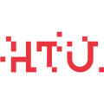

Welcome to
“ Cryptography ”
Session

Slide 2
WHOAMI?
Abdulrahman Melhem
★ 2nd Year Cyber Security Student
★ CTF Department member

Slide 3


Part 1: Data representations and essential functions in Python

Slide 4

Data representations and essential functions in Python
Data Types:
The computer system uses a variety of forms that represent the same data. We can use:
Integer (int) values: Range from 0-9, Example: 79, 80, 5, 1337.
String (str) values: All printable characters. Example: "Hi !!!", "ONE1two2?".
Hexadecimal (hex) values: Range From 0-9 and A-F. Example: 2A66FF32.
Binary (bin) value: Range from 0-1. Example: 00110110101

Slide 5
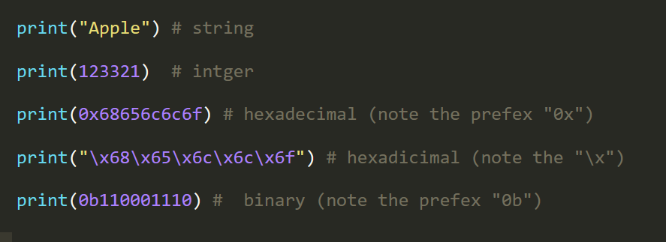
Data representations and essential functions in Python

Slide 6
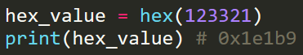
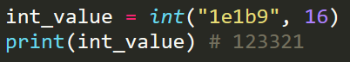
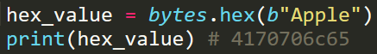

Data representations and essential functions in Python
Conversations:
The computer system uses a variety of forms that represent the same data. We can use:
Int to Hex
Hex to Int
String to Hex
Hex to String

Slide 7
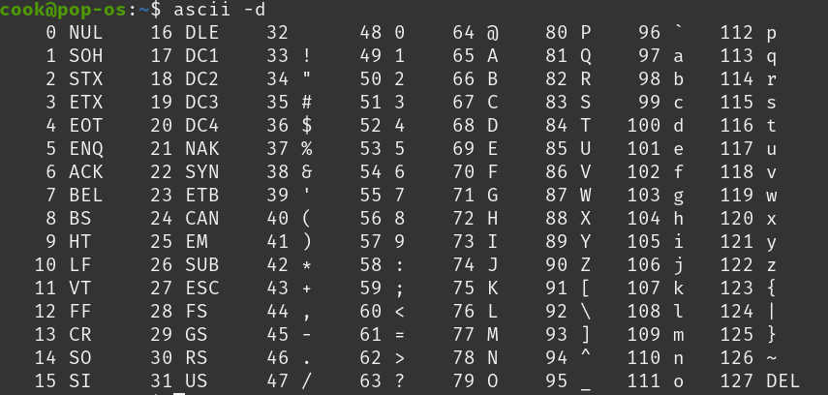
Data representations and essential functions in Python
ASCII:
Each character (whether is it alphanumeric or symbols) , all have an integer value equal to it.
These values are organized and saved in a table called ASCII table.

Slide 8
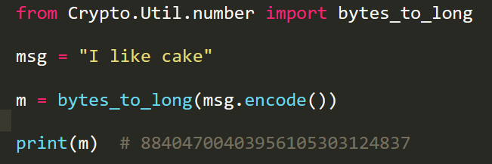
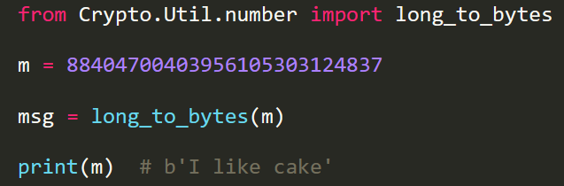
Data representations and essential functions in Python
Sending messages in Cryptography:
We will encounter later on different types of encryption.
They all deal with numbers. No string text is involved. How is that?
[ pip3 install pycryptodome ]
Text to Numbers
Numbers to text

Slide 9
Part 2: Known Public Ciphers

Slide 10
WHOAMI?
Abdallah Mesleh
★ Blue teaming member @CSC
★ Cryptography Enthusiast
★ Third Year Cyber Security Student

Slide 11
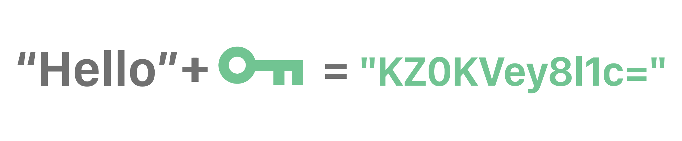
What are encryption keys?
Encryption keys are used to make the ciphertext unique, randomized and unpredictable.
For example, a key could be a binary representation, such as:
Key: 10101010

Slide 12
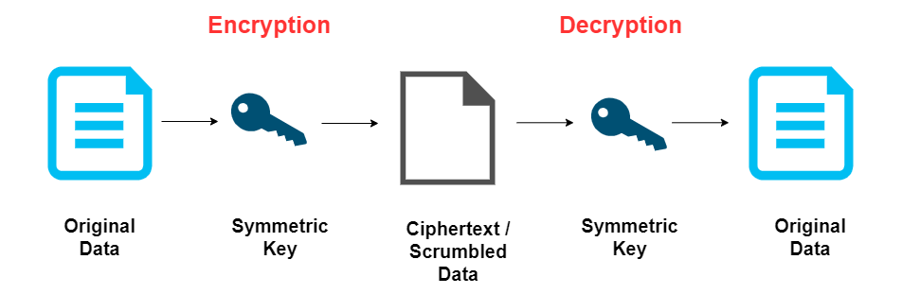
Known Public Ciphers
Symmetric Cryptography
Type of encryption algorithms.
The key used for encryption, is used also for decryption.
Example: one-time pad

Slide 13
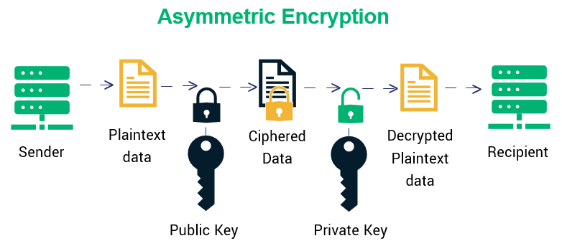
Known Public Ciphers
Asymmetric Cryptography
Type of encryption algorithms.
The key used for encryption, is not used for decryption.
Example: RSA

Slide 14
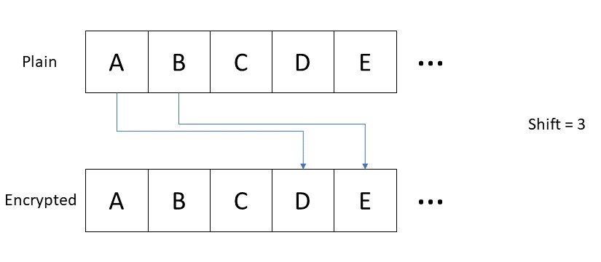
Known Public Ciphers
Caeser Cipher
An old substitution cipher, that needs 2 pieces of information to work:
The message to be sent.
The key.
The key is a number that specifies how many chars in the alphabetic order we should walk over.

Slide 15
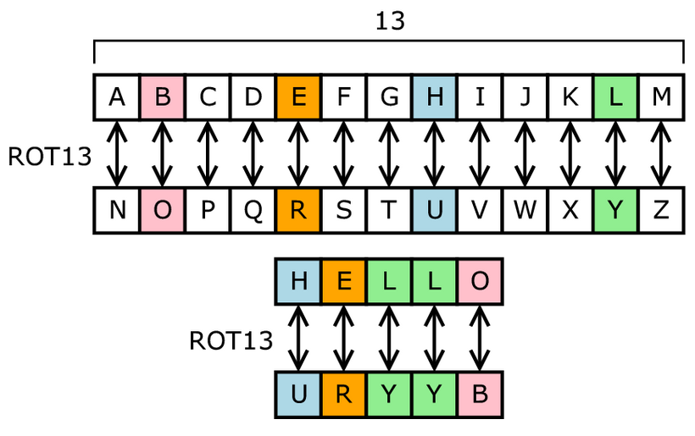
Known Public Ciphers
ROT13
This is the same as Caesar Cipher but with a key of 13 (you can change it if you want).
https://rot13.com

Slide 16
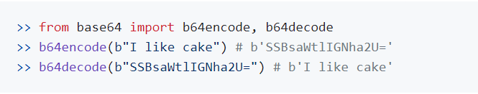
Known Public Ciphers
Base64 encoding:
It is not an encryption schema, but an encoding type.
It changes the format of the data without the need to use a key.
Using Python:
You can also CyberChef for quick encoding/decoding.

Slide 17
Part 3: Bitwise Operations

Slide 18
Bitwise Operations
XOR ( ^ , ⊕ )
It works by comparing the binary bits and asks itself on each round: "Are they different?", if yes print 1, 0 otherwise.
01001100 01001100 01001100
01101010 00000000 11111111
----------------- --------------- ---------------
00100110 01001100 10110011
In python:
Using ( ^ ) symbol.
xor() function from pwntools library.

Slide 19
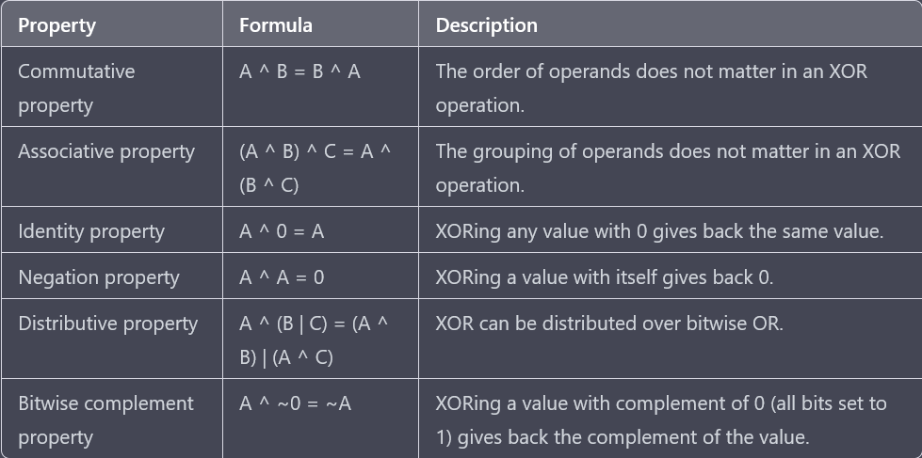
Bitwise Operations
XOR Properties

Slide 20
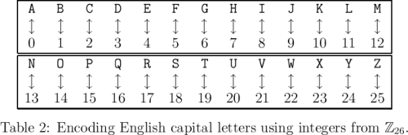
Bitwise Operations
The one-time pad
It works by XORing our message with a key, which is only used once. It was used in the cold war, between Moscow and Washington DC. It works simply by XORing the message with the key, for encrypting and decrypting.
Original Message: CSC
Message in binary: 00010 10010 00010
XORing with a key: 11111 11111 11111
Ciphertext: 11101 01101 11101
To decrypt this message, we XOR it again with the original key, which shows a symmetric encryption.
Decrypting:
Ciphertext: 11101 01101 11101
Key: 11111 11111 11111
Original Message: 00010(2) 10010(18) 00010(2)

Slide 21
Bitwise Operations
Logical Bit Shifting
There are other methods used to manipulate the bits of some data.
They were used originally to fasten the mathematical calculations.
Right Shifting ( >> ):
The resulting value is larger.
Mathematically, it is as same as multiplying the given number by 2^{shift_value} .
Left Shifting ( << ):
The resulting value is smaller.
Mathematically, it is the floor division ( // ) of the given number by 2^{shift_value} .
0010 << 1 = 0100 0010 >> 1 = 0001

Slide 22
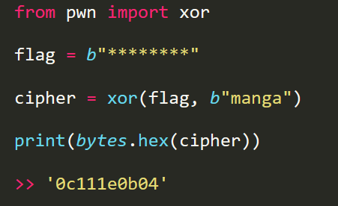
Bitwise Operations
XOR example code

Slide 23
Part 4: RSA

Slide 24
WHOAMI?
Ibrahim Sadeq
★ Blue team department member @CSCHTU
★ Third Year Cyber Security Student
HOBBIES:
★ Searching for knowledge
★ Concle gaming

Slide 25
RSA
Main Elements
N, a number to be used in the mod % .
It can be the product of 2 primes (p, q), N = p * q .
It can be a large prime number.
Φ(N) = (p-1) (q-1)
e , a public exponent ( x^{e} ).
Its value depends on how N was calculated.
Should be relatively prime with Φ(N), i.e. GCD(e, Φ(N)) = 1 .
Range between ( 1 - Φ(N) ).
d, private exponent ( x^{d} ).
m , the message or the plain text (in numbers).
c , the cipher text (in numbers).

Slide 26
RSA
Encryption and Decryption
The cipher text (c) = m^{e} mod N , pow(m, e, N)
The plain text (m) = c^{d} mod N , pow(c, d, N)
How to find d ?
d is the multiplicative inverse of e in Z_{Φ(n)} .
The totient (Φ/phi) value's calculation includes these cases:
If N is a prime number: Φ(N) = N - 1 .
If N is the product of p and q: Φ(N) = (p-1) * (q-1) .

Slide 27
RSA
Then you can find d by one of the following methods:
pow(e, -1, totient) .
inverse(e,phi) .

Slide 28
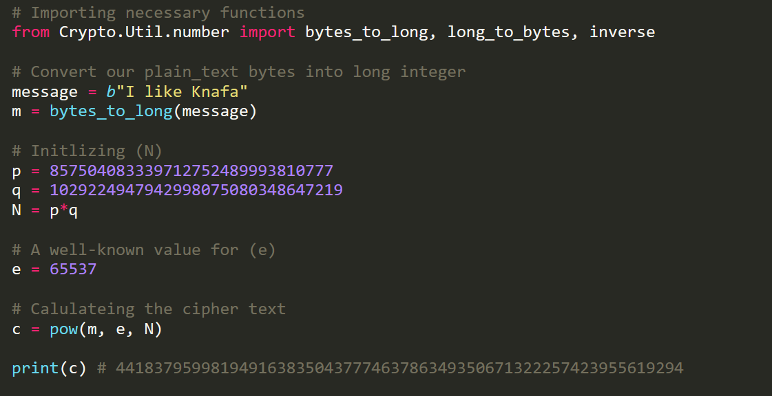
RSA
Encryption

Slide 29
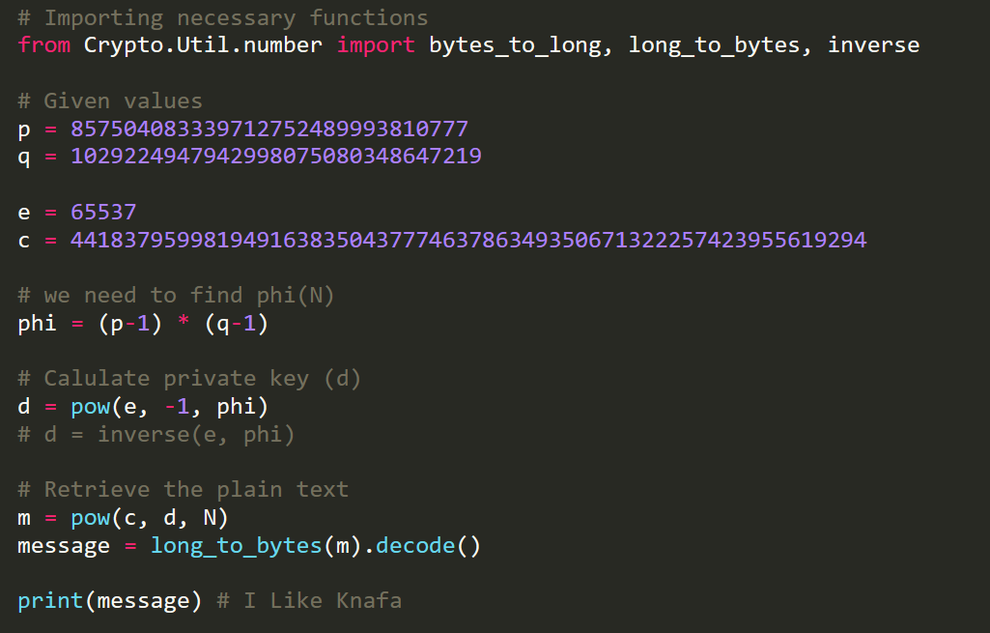
RSA
Decryption

Slide 30

15 minutes break

Slide 31
Lab 101

Slide 32






